Slide 1
DDCA Project
TEAM MEMBERS
PARVATHANENI PAVAN VIRESH CHOWDARY
2620040035
PENDLI SLESHA REDDY
2620040036
JALADI ROHITA
2620040040
VEERNALA SAI RAM VENKATA SATHWIK
2620040073
KLH University, Bachupally, Hyderabad
Gray Code to Binary Converter
1
0
0
1

Slide 2
Problem Statement
Understand
Learn how Gray code changes only one bit per step
OBJECTIVE
Design a Gray code to binary converter and explain its working and applications.
1
Design
Derive logic equations and build it with XOR gates
2
Apply
Verify with a truth table and real-world uses
3

Slide 3
What is Gray Code?
A binary system where consecutive values differ in only one bit
Also known as reflected binary code
Prevents errors when many bits would change at once
Decimal | Binary | Gray
0 | 000 | 000
1 | 001 | 001
2 | 010 | 011
3 | 011 | 010
4 | 100 | 110
5 | 101 | 111
6 | 110 | 101
7 | 111 | 100
1 bit
changes between every two consecutive codes

Slide 4
Working: Gray to Binary
The MSB stays the same. Each next binary bit is the previous binary bit XOR the current Gray bit.
WORKED EXAMPLE
Gray code: 1101
B3 = G3
B2 = B3 ⊕ G2
B3 = 1
B2 = 1 ⊕ 1 = 0
B1 = 0 ⊕ 0 = 0
B0 = 0 ⊕ 1 = 1
B1 = B2 ⊕ G1
B0 = B1 ⊕ G0
Binary: 1001
⊕ is XOR: the output is 1 only when the two inputs differ.

Slide 5
Circuit Design (4-bit)
G3
G2
G1
G0
Gray code input
XOR
XOR
XOR
XOR gate
B3
B2
B1
B0
Binary output
Only 3 XOR gates are needed for 4 bits. Each output feeds the next gate.

Slide 6
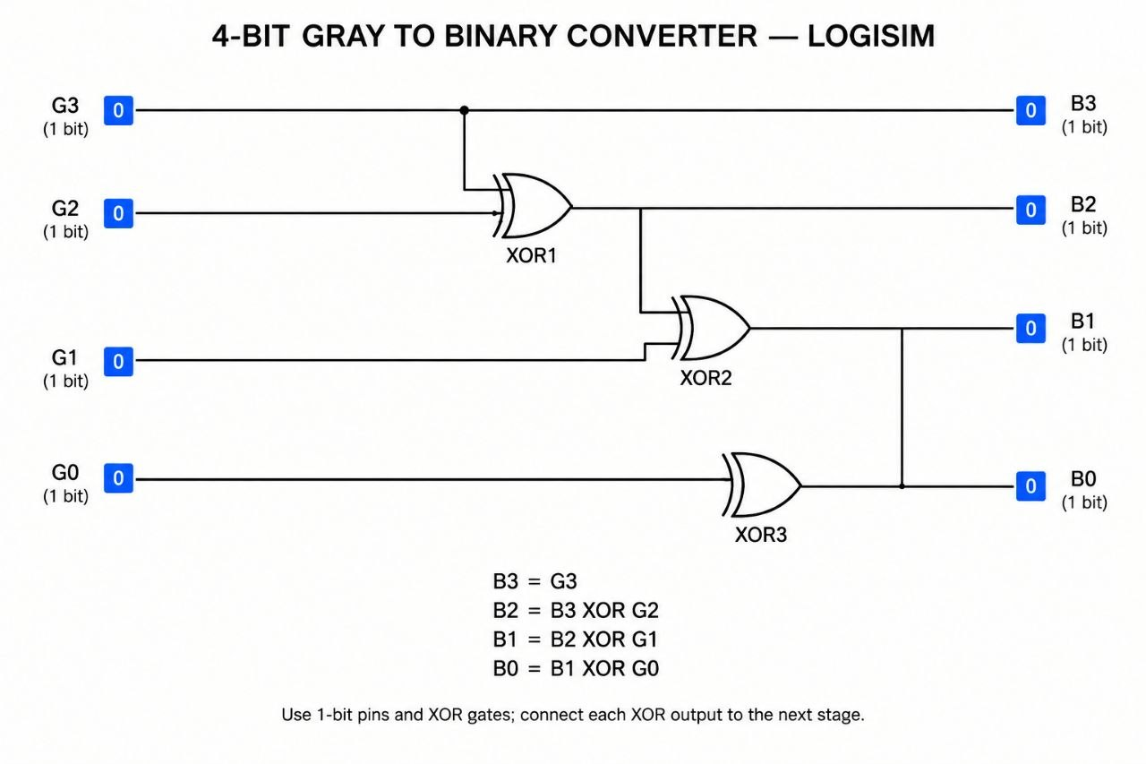

Slide 7
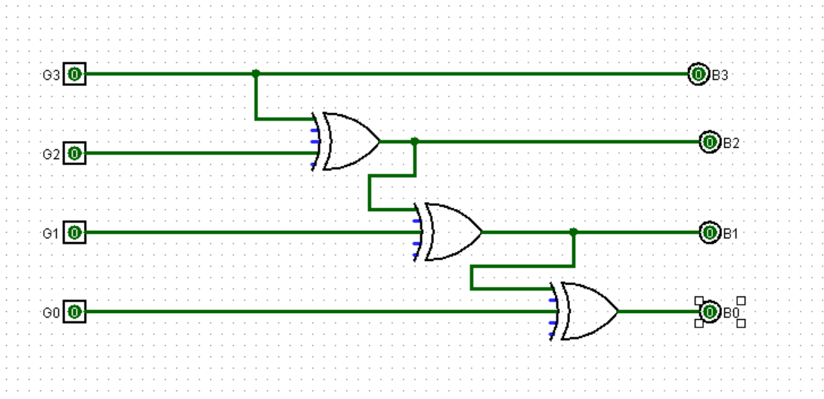

Slide 8
Applications
1
2
3
Rotary Encoders
Position sensing with no false readings
Analog-to-Digital
Safer code transitions in converters
Asynchronous FIFOs
Pointers cross clock domains safely
4
5
6
K-Map Design
Gray order simplifies logic minimization
Low-Power Counters
One bit flips per count, less switching
Robotics and Sensors
Reliable angle and position feedback

Slide 9
Thank You
1
0
0
1
Gray Code to Binary Converter | DDCA Project

